Slide 1

JAWAHARLAL DARDA INSTITUTE OF ENGINEERING & TECHNOLOGY
Yavatmal - 445001
Department of Computer Science & Engineering
“AN AUTOMATIC DETECTION & COUNTING OF RBCs BY USING IP”
Group Members:
Aachal M. Rekalwar
Vaishnavi P. Wadi
Reeya N. Dhakate
Mrunal V. Ambhore
Under the Guidance Of : Prof. M. K. Popat
Year - 2023-2024

Slide 2
Introduction
Technology plays a pivotal role in enhancing precision and efficiency
Focus on an automated RBCs & WBCs detection and counting system
Leukemia Detection based on Classification
Leukemia Types

Slide 3
Problem Statement
Manual Counting Limitations
Technical Expertise
Time-Consuming
Accuracy & Statement
Complexity of Cell Classification

Slide 4
Proposed System
In proposed work, Images are classified on the basis of color, texture and morphology.
Image Acquisition
Image Preprocessing & Enhancement
Image Segmentation
Feature Extraction
Classification of SVM Model
Image Recognition

Slide 5
Objective of System
Developing an Automated RBC Counting Algorithm
Feature Extraction and Representation
Efficiency and Speed Enhancement
Improve accuracy, reducing manual errors
User-Friendly Software Implementation

Slide 6
Scope of Work
Image Processing and SVM Model Integration
Accuracy Enhancement
Multiclass Classification Precision
Color Features Utilization
Future Research Application
Comprehensive Dataset Development

Slide 7
Operating Environment
Hardware Requirements
Processor: I3 / I5/ Processor
RAM: 4 GB RAM or More
Hard Disk: 20GB or More
Monitor Resolution: 800 x 600 higher recommended
Software Requirements
Operating System: Window 10 or above
Python Language
Django BackendFramework
Web Browser: Chrome
VsCode IDE (Integrated Development Environment)
SQLite Database

Slide 8
Technology Used
Front-End Technologies
HTML
CSS
JavaScript
Bootstrap (version 5)
Back-End Technologies
Python Language
NumPy, Pandas, sklearn, opencv, and so on
Machine Learning Algorithm: SVM (Support Vector Machine)
SQLite Database

Slide 9
Methodology
Initiate with blood image acquisition
Image Preprocessing & Enhancement
Image Segmentation
Segmentation Methods
Thresholding
Morphological Operations
Feature Extraction

Slide 10
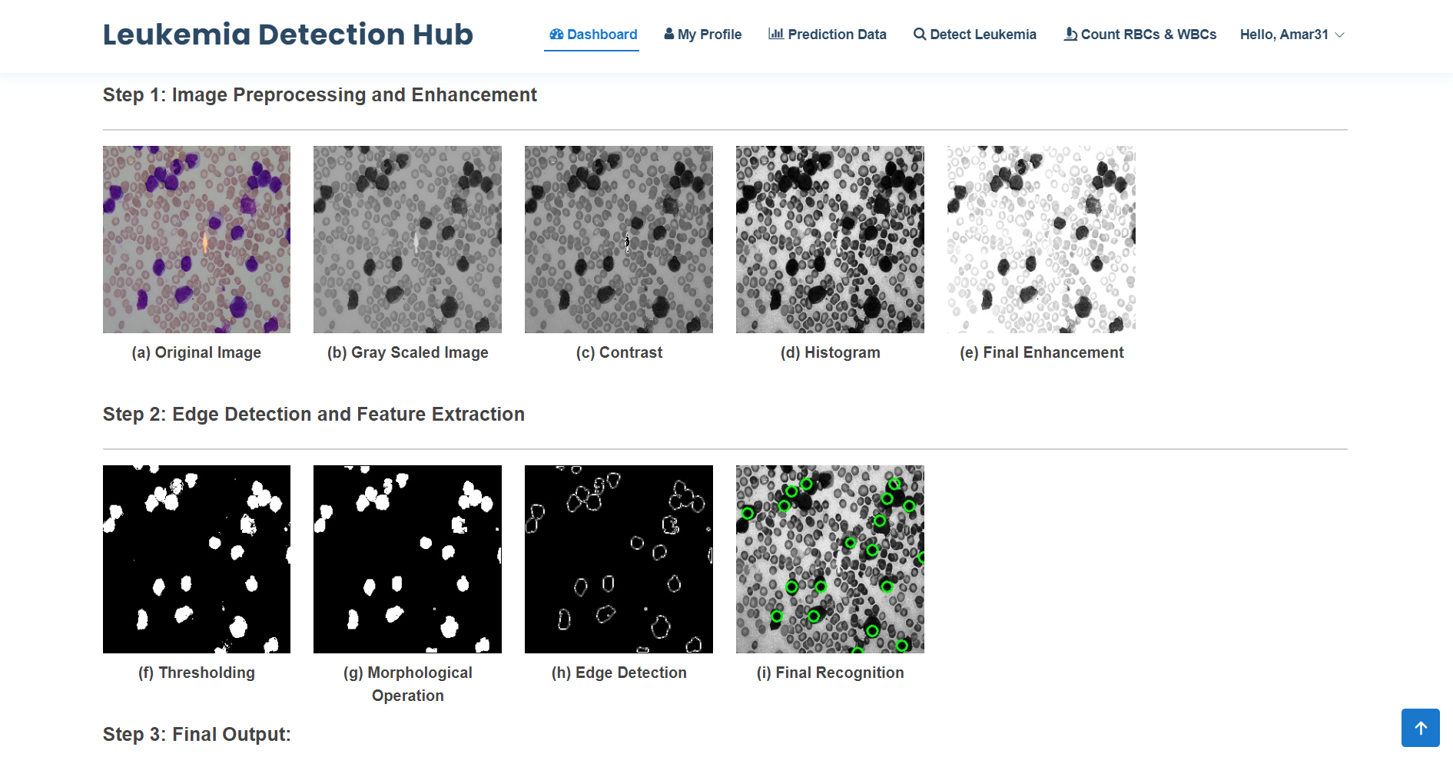
Expected Output – Leukemia Detected

Slide 11

Expected Output – Leukemia Detected

Slide 12
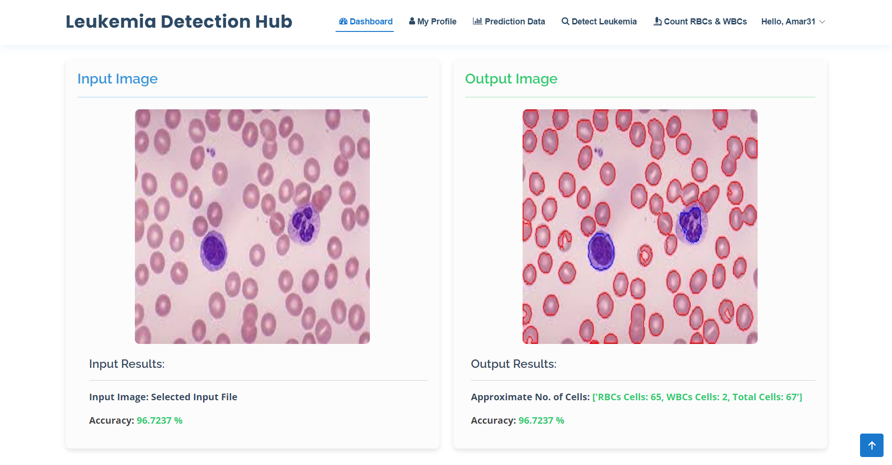
Expected Output – Calculate RBCs

Slide 13
Drawbacks and Limitations
Image Quality Dependency
Algorithm Sensitivity
Technical Issues

Slide 14
Conclusion
Enhanced Efficiency
Improved Accuracy

Slide 15


